Slide 1

DIVINE GRACE COLLEGE OF ARTS, SCIENCE AND TECHNOLOGY
(DGCAST) — GAROUA | GEOGRAPHY DEPARTMENT
UPPER SIXTH ARTS — ECONOMIC GEOGRAPHY — FURTHER STUDY 1
Agricultural Development and Change in Cameroon
Mr KAMDEM EMMANUEL
Geography Teacher — PLEG
Academic Year 2026 / 2027
Notes:
Good morning, class. Today we study Further Study 1: Agricultural Development and Change in Cameroon.

Slide 2
GEOGRAPHY — UPPER SIXTH ARTS
CLASS INFO
Class, Chapter & Duration
Class | Upper Sixth Arts
Chapter | Module 6: Understanding and managing the dynamics of economic activities across the world in general and Cameroon in particular
Duration | 2 periods (2 × 50 minutes)
2026 / 2027
DGCAST GAROUA — GEOGRAPHY DEPARTMENT
Mr KAMDEM E. | 2

Slide 3
GEOGRAPHY — UPPER SIXTH ARTS
IDENTIFICATION
Lesson Identification
Topic | Geography of Cameroon
Sub-topic | Agricultural Systems and Patterns of Cameroon
Lesson | Further Study 1: Agricultural Development and Change in Cameroon
Notions / Concepts | Peasant farming, plantation, livestock, CDC, SODECOTON, second-generation agriculture.
Syllabus focus | Characteristics and importance of agriculture; peasant, plantation and livestock systems and their factors; impacts; problems and solutions; changes since independence.
Competence | Learners are able to describe the agricultural systems of Cameroon and explain their problems and changes.
2026 / 2027
DGCAST GAROUA — GEOGRAPHY DEPARTMENT
Mr KAMDEM E. | 3

Slide 4
GEOGRAPHY — UPPER SIXTH ARTS
OBJECTIVES
Learning Objectives
By the end of the lesson, the learner should be able to:
Describe the characteristics and systems of agriculture in Cameroon.
Explain the factors and impacts of these systems.
Explain the problems, solutions and changes since independence.
2026 / 2027
DGCAST GAROUA — GEOGRAPHY DEPARTMENT
Mr KAMDEM E. | 4

Slide 5
GEOGRAPHY — UPPER SIXTH ARTS
RECALL
Recall
Cameroon grows cocoa, coffee, cotton and bananas.
Farming systems are intensive or extensive.
2026 / 2027
DGCAST GAROUA — GEOGRAPHY DEPARTMENT
Mr KAMDEM E. | 5

Slide 6
GEOGRAPHY — UPPER SIXTH ARTS
REAL-LIFE SITUATION
Real-Life Situation
In the South-West, the CDC runs huge plantations of banana, palm and rubber. Nearby, peasant farmers grow cassava and cocoa on small plots with hoes. In the Adamawa, herders keep cattle on open grassland.
2026 / 2027
DGCAST GAROUA — GEOGRAPHY DEPARTMENT
Mr KAMDEM E. | 6
Notes:
Read the situation slowly, twice.

Slide 7
GEOGRAPHY — UPPER SIXTH ARTS
REAL-LIFE SITUATION
Situation — Question 1
What is the problem in the situation?
2026 / 2027
DGCAST GAROUA — GEOGRAPHY DEPARTMENT
Mr KAMDEM E. | 7

Slide 8
GEOGRAPHY — UPPER SIXTH ARTS
REAL-LIFE SITUATION
Answer
Cameroon has very different farming systems.
2026 / 2027
DGCAST GAROUA — GEOGRAPHY DEPARTMENT
Mr KAMDEM E. | 8

Slide 9
GEOGRAPHY — UPPER SIXTH ARTS
REAL-LIFE SITUATION
Situation — Question 2
Which system uses large estates and many workers?
2026 / 2027
DGCAST GAROUA — GEOGRAPHY DEPARTMENT
Mr KAMDEM E. | 9

Slide 10
GEOGRAPHY — UPPER SIXTH ARTS
REAL-LIFE SITUATION
Answer
The plantation system.
2026 / 2027
DGCAST GAROUA — GEOGRAPHY DEPARTMENT
Mr KAMDEM E. | 10

Slide 11
GEOGRAPHY — UPPER SIXTH ARTS
REAL-LIFE SITUATION
Situation — Question 3
Which system is most common?
2026 / 2027
DGCAST GAROUA — GEOGRAPHY DEPARTMENT
Mr KAMDEM E. | 11

Slide 12
GEOGRAPHY — UPPER SIXTH ARTS
REAL-LIFE SITUATION
Possible Answer
Peasant (small-scale) farming.
2026 / 2027
DGCAST GAROUA — GEOGRAPHY DEPARTMENT
Mr KAMDEM E. | 12

Slide 13
GEOGRAPHY — UPPER SIXTH ARTS
JUSTIFICATION
Justification of the Lesson
This further study helps us to understand the farming of our own country.
2026 / 2027
DGCAST GAROUA — GEOGRAPHY DEPARTMENT
Mr KAMDEM E. | 13

Slide 14
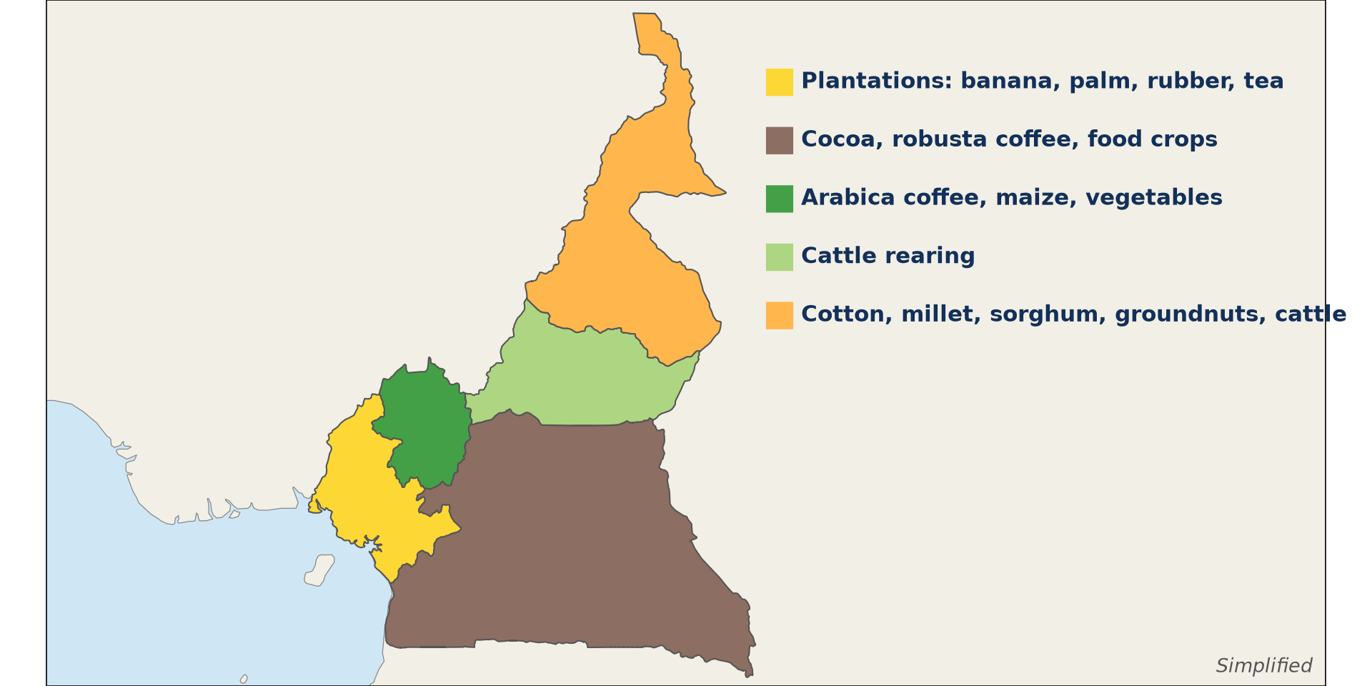
GEOGRAPHY — UPPER SIXTH ARTS
I. DISTRIBUTION
Activity 1
Main farming regions of Cameroon (simplified).
2026 / 2027
DGCAST GAROUA — GEOGRAPHY DEPARTMENT
Mr KAMDEM E. | 14
Notes:
Without the projector: draw the map.

Slide 15
GEOGRAPHY — UPPER SIXTH ARTS
I. DISTRIBUTION
Activity 1: Question
Name the main crop of the North and the main crop of the Centre and South.
2026 / 2027
DGCAST GAROUA — GEOGRAPHY DEPARTMENT
Mr KAMDEM E. | 15

Slide 16
GEOGRAPHY — UPPER SIXTH ARTS
I. DISTRIBUTION
Answer
North: cotton. Centre and South: cocoa.
2026 / 2027
DGCAST GAROUA — GEOGRAPHY DEPARTMENT
Mr KAMDEM E. | 16

Slide 17

GEOGRAPHY — UPPER SIXTH ARTS
II. PEASANT FARMING
Activity 2
A small family farm.
2026 / 2027
DGCAST GAROUA — GEOGRAPHY DEPARTMENT
Mr KAMDEM E. | 17
Notes:
Without the projector: describe a family farm.

Slide 18
GEOGRAPHY — UPPER SIXTH ARTS
II. PEASANT FARMING
Activity 2: Question
Give three characteristics of peasant farming.
2026 / 2027
DGCAST GAROUA — GEOGRAPHY DEPARTMENT
Mr KAMDEM E. | 18

Slide 19
GEOGRAPHY — UPPER SIXTH ARTS
II. PEASANT FARMING
Answer
Small plots, family labour, simple tools, mixed food and cash crops.
2026 / 2027
DGCAST GAROUA — GEOGRAPHY DEPARTMENT
Mr KAMDEM E. | 19

Slide 20
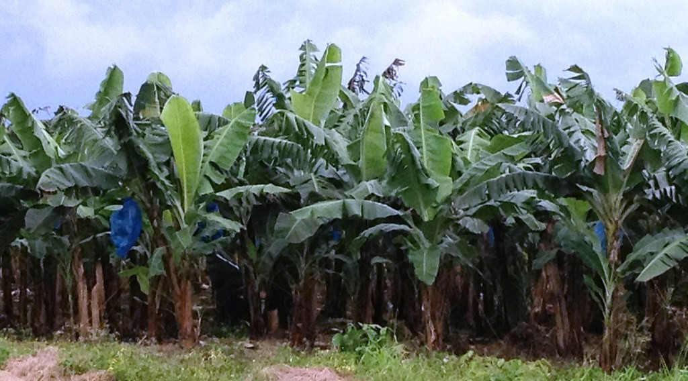
GEOGRAPHY — UPPER SIXTH ARTS
III. PLANTATIONS
Activity 3
A banana plantation.
2026 / 2027
DGCAST GAROUA — GEOGRAPHY DEPARTMENT
Mr KAMDEM E. | 20
Notes:
Without the projector: mention CDC and PHP.

Slide 21
GEOGRAPHY — UPPER SIXTH ARTS
III. PLANTATIONS
Activity 3: Question
Give three characteristics of plantation agriculture.
2026 / 2027
DGCAST GAROUA — GEOGRAPHY DEPARTMENT
Mr KAMDEM E. | 21

Slide 22
GEOGRAPHY — UPPER SIXTH ARTS
III. PLANTATIONS
Answer
Large estates, one crop, many paid workers, much capital, for export.
2026 / 2027
DGCAST GAROUA — GEOGRAPHY DEPARTMENT
Mr KAMDEM E. | 22

Slide 23

GEOGRAPHY — UPPER SIXTH ARTS
IV. LIVESTOCK
Activity 4
Cattle.
2026 / 2027
DGCAST GAROUA — GEOGRAPHY DEPARTMENT
Mr KAMDEM E. | 23
Notes:
Without the projector: discuss transhumance.

Slide 24
GEOGRAPHY — UPPER SIXTH ARTS
IV. LIVESTOCK
Activity 4: Question
Where are most cattle reared in Cameroon? Why?
2026 / 2027
DGCAST GAROUA — GEOGRAPHY DEPARTMENT
Mr KAMDEM E. | 24

Slide 25
GEOGRAPHY — UPPER SIXTH ARTS
IV. LIVESTOCK
Answer
Adamawa and the north: grasslands and fewer tsetse flies.
2026 / 2027
DGCAST GAROUA — GEOGRAPHY DEPARTMENT
Mr KAMDEM E. | 25

Slide 26
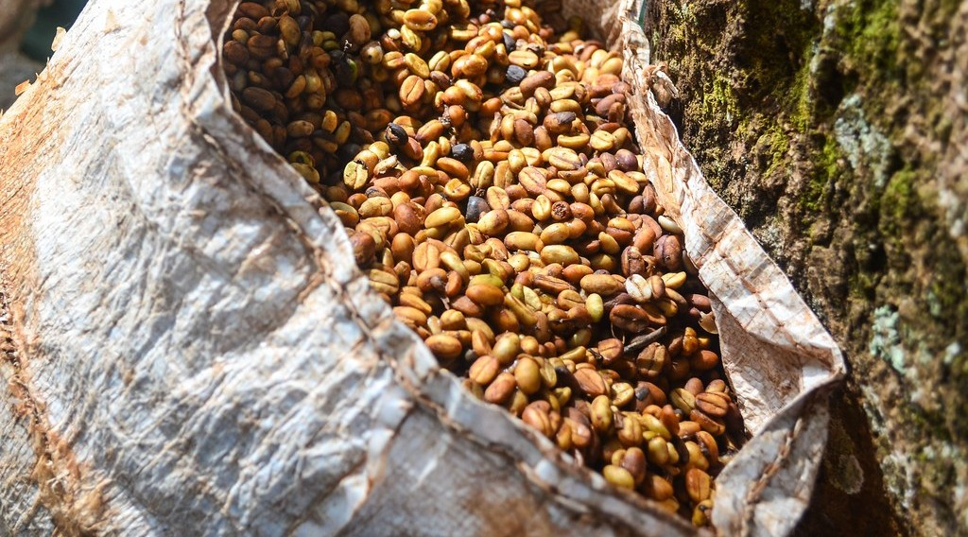
GEOGRAPHY — UPPER SIXTH ARTS
V. PROBLEMS AND CHANGES
Activity 5
Harvesting coffee.
2026 / 2027
DGCAST GAROUA — GEOGRAPHY DEPARTMENT
Mr KAMDEM E. | 26
Notes:
Without the projector: discuss problems.

Slide 27
GEOGRAPHY — UPPER SIXTH ARTS
V. PROBLEMS AND CHANGES
Activity 5: Question
Give two problems of agriculture and one change since independence.
2026 / 2027
DGCAST GAROUA — GEOGRAPHY DEPARTMENT
Mr KAMDEM E. | 27

Slide 28
GEOGRAPHY — UPPER SIXTH ARTS
V. PROBLEMS AND CHANGES
Answer
Problems: poor roads, low prices. Change: agro-industrial companies and second-generation agriculture.
2026 / 2027
DGCAST GAROUA — GEOGRAPHY DEPARTMENT
Mr KAMDEM E. | 28

Slide 29
GEOGRAPHY — UPPER SIXTH ARTS
BOARD SUMMARY
Agricultural Development and Change in Cameroon
Topic: Geography of Cameroon
Sub-topic: Agricultural Systems and Patterns of Cameroon
Further Study 1: Agricultural Development and Change in Cameroon
2026 / 2027
DGCAST GAROUA — GEOGRAPHY DEPARTMENT
Mr KAMDEM E. | 29
Notes:
Learners copy the board summary now. Give them enough time for each slide.

Slide 30
GEOGRAPHY — UPPER SIXTH ARTS
BOARD SUMMARY
I. Definitions
Peasant farming: It is small-scale family farming with simple tools.
Plantation: It is a large estate growing one cash crop for export.
Second-generation agriculture: It is Cameroon's policy to modernise and industrialise farming.
2026 / 2027
DGCAST GAROUA — GEOGRAPHY DEPARTMENT
Mr KAMDEM E. | 30

Slide 31
GEOGRAPHY — UPPER SIXTH ARTS
BOARD SUMMARY
II. Systems and their Distribution (1/2)
A. Peasant farming: It produces most food crops and much cocoa and coffee. Farms are small and use family labour and hoes.
B. Plantations: CDC, PHP and SOCAPALM grow banana, palm, rubber and tea in the South-West and Littoral. They use much capital and paid workers.
2026 / 2027
DGCAST GAROUA — GEOGRAPHY DEPARTMENT
Mr KAMDEM E. | 31

Slide 32
GEOGRAPHY — UPPER SIXTH ARTS
BOARD SUMMARY
II. Systems and their Distribution (2/2)
C. Livestock: Traditional herding dominates in the Adamawa and the north. Modern ranches and poultry farms are growing.
2026 / 2027
DGCAST GAROUA — GEOGRAPHY DEPARTMENT
Mr KAMDEM E. | 32

Slide 33
GEOGRAPHY — UPPER SIXTH ARTS
BOARD SUMMARY
III. Factors, Problems and Changes (1/3)
A. Factors: Climate, soils, relief, markets and history explain the pattern. Colonial plantations were set on fertile volcanic soils.
B. Problems: Droughts, poor soils, pests and floods are physical problems. Poor roads, storage, credit, land tenure and low prices are human problems.
2026 / 2027
DGCAST GAROUA — GEOGRAPHY DEPARTMENT
Mr KAMDEM E. | 33

Slide 34
GEOGRAPHY — UPPER SIXTH ARTS
BOARD SUMMARY
III. Factors, Problems and Changes (2/3)
C. Changes and solutions: Research (IRAD), cooperatives, SODECOTON and irrigation schemes improved farming. Second-generation agriculture aims at mechanisation and processing.
2026 / 2027
DGCAST GAROUA — GEOGRAPHY DEPARTMENT
Mr KAMDEM E. | 34

Slide 35
GEOGRAPHY — UPPER SIXTH ARTS
BOARD SUMMARY
III. Factors, Problems and Changes (3/3)
Copy the map.
2026 / 2027
DGCAST GAROUA — GEOGRAPHY DEPARTMENT
Mr KAMDEM E. | 35

Slide 36
GEOGRAPHY — UPPER SIXTH ARTS
FORMATIVE EVALUATION
Formative Evaluation 1
Compare peasant farming and plantation agriculture in Cameroon.
2026 / 2027
DGCAST GAROUA — GEOGRAPHY DEPARTMENT
Mr KAMDEM E. | 36

Slide 37
GEOGRAPHY — UPPER SIXTH ARTS
FORMATIVE EVALUATION
Expected Answer
Peasant: small plots, family labour, food crops. Plantation: large estates, paid labour, export crops.
2026 / 2027
DGCAST GAROUA — GEOGRAPHY DEPARTMENT
Mr KAMDEM E. | 37

Slide 38
GEOGRAPHY — UPPER SIXTH ARTS
FORMATIVE EVALUATION
Formative Evaluation 2
Give three problems of agriculture in Cameroon.
2026 / 2027
DGCAST GAROUA — GEOGRAPHY DEPARTMENT
Mr KAMDEM E. | 38

Slide 39
GEOGRAPHY — UPPER SIXTH ARTS
FORMATIVE EVALUATION
Expected Answer
Poor roads, low prices, pests (also drought, credit, storage).
2026 / 2027
DGCAST GAROUA — GEOGRAPHY DEPARTMENT
Mr KAMDEM E. | 39

Slide 40
GEOGRAPHY — UPPER SIXTH ARTS
REMEDIATION
Remediation
Fill in the blanks:
The CDC runs ______ in the South-West.
Cotton is grown in the ______.
Most cattle are in the ______.
2026 / 2027
DGCAST GAROUA — GEOGRAPHY DEPARTMENT
Mr KAMDEM E. | 40
Notes:
Answers: 1. plantations 2. North 3. Adamawa

Slide 41
GEOGRAPHY — UPPER SIXTH ARTS
HOMEWORK
Homework
Draw the farming map of Cameroon and write one crop per region.
This prepares Further Study 2: Management of Forest Resources.
2026 / 2027
DGCAST GAROUA — GEOGRAPHY DEPARTMENT
Mr KAMDEM E. | 41
Notes:
This homework prepares the next lesson.

Slide 42
GEOGRAPHY — UPPER SIXTH ARTS
BILINGUAL GAME
Bilingual Game (Jeu Bilingue)
English | Français
Plantation | La plantation
Peasant | Le paysan
Livestock | L'élevage
Cooperative | La coopérative
Cocoa | Le cacao
Cotton | Le coton
2026 / 2027
DGCAST GAROUA — GEOGRAPHY DEPARTMENT
Mr KAMDEM E. | 42
Notes:
Say the English word; learners give the French word, then the reverse.

Slide 43
GEOGRAPHY — UPPER SIXTH ARTS
LOGBOOK
Official Logbook (1/2)
Module / Topic | Geography of Cameroon
Lesson Title | Further Study 1: Agricultural Development and Change in Cameroon
Expected Learning Outcomes | Describe the characteristics and systems of agriculture in Cameroon. Explain the factors and impacts of these systems. Explain the problems, solutions and changes since independence.
Competence | Learners are able to describe the agricultural systems of Cameroon and explain their problems and changes.
2026 / 2027
DGCAST GAROUA — GEOGRAPHY DEPARTMENT
Mr KAMDEM E. | 43

Slide 44
GEOGRAPHY — UPPER SIXTH ARTS
LOGBOOK
Official Logbook (2/2)
Matter Taught | I. Definitions: Peasant farming, Plantation, Second-generation agriculture; II. Systems and their Distribution: Peasant farming, Plantations, Livestock; III. Factors, Problems and Changes: Factors, Problems, Changes and solutions.
Evaluation | Formative evaluation (3 questions) and remediation exercise.
Homework | Draw the farming map of Cameroon and write one crop per region.
Enrolment / Present / Absent | ____ / ____ / ____
Achievement | To be completed by the teacher after the lesson.
2026 / 2027
DGCAST GAROUA — GEOGRAPHY DEPARTMENT
Mr KAMDEM E. | 44

Slide 45
GEOGRAPHY — UPPER SIXTH ARTS
TEACHER'S NOTE
Teacher's Note
Timing: Set-up, recall 8 min | Situation 8 min | 5 activities 30 min | Board summary (copying) 30 min | Evaluation, remediation 10 min | Homework, logbook 9 min | Spare 5 min
2026 / 2027
DGCAST GAROUA — GEOGRAPHY DEPARTMENT
Mr KAMDEM E. | 45

Slide 46
GEOGRAPHY — UPPER SIXTH ARTS
REFERENCES
References
National Geography Syllabus, Sixth Forms (Lower & Upper Sixth), MINESEC/IGE/IP-SS, August 2019 — Module 6 (Economic Geography).
Photo, Activity 2: “Cameroon - UN Women's Gender Road Project” by UN Women Gallery, CC BY-NC-ND 2.0, via Flickr (https://www.flickr.com/photos/51431730@N04/46914753474)
Photo, Activity 3: “Banana Plantation” by AfricaTravelAssociation, CC BY 2.0, via Flickr (https://www.flickr.com/photos/65134942@N06/8164706151)
Photo, Activity 4: “Fulani cattle breed of West Africa” by International Livestock Research Institute, CC BY-NC-SA 2.0, via Flickr (https://www.flickr.com/photos/7155605@N03/48125675226)
Photo, Activity 5: “Harvesting coffee, Cameroon” by jbdodane, CC BY-NC 2.0, via Flickr (https://www.flickr.com/photos/27998473@N02/11590251453)
Diagrams and animations: drawn for this lesson (DGCAST Geography Department).
2026 / 2027
DGCAST GAROUA — GEOGRAPHY DEPARTMENT
Mr KAMDEM E. | 46

